Slide 1
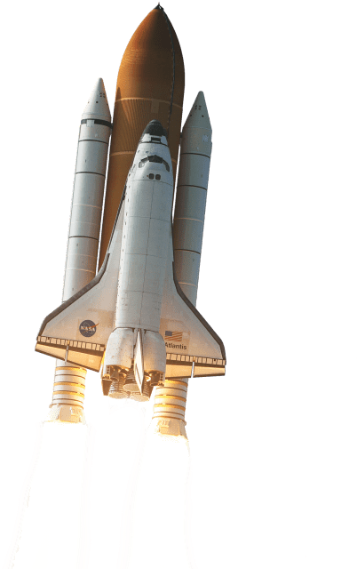
MD.Assaduzzaman 2018-1-60-081
Durjoyn Barua 2018-1-60-137
Nahid Hasan Ashik 2017-2-60-080

Slide 2
Orbital Thrust Problem of Space Aircraft

Slide 3
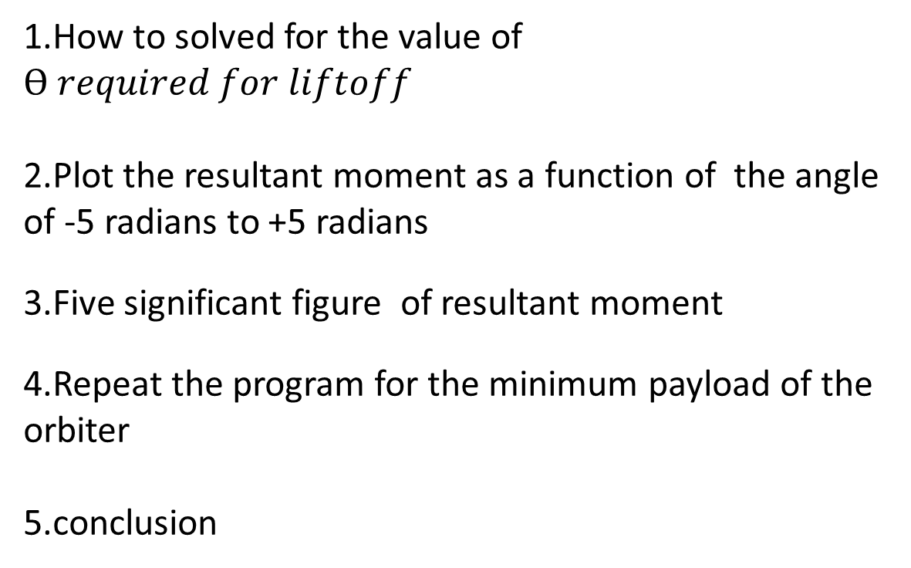
overview
1.How to solved for the value of $Ө required for liftoff$
2.Plot the resultant moment as a function of the angle of -5 radians to +5 radians
3.Five significant figure of resultant moment
4.Repeat the program for the minimum payload of the orbiter
5.conclusion

Slide 4
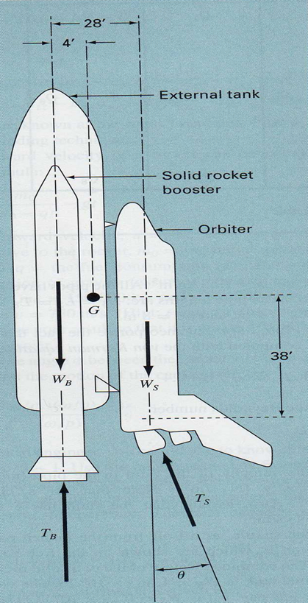
A space shuttle lift- off from the launch pad has four forces acting on it
Which are
WB => Combined weight of the two solid rocket boosters and fuel tanks
WS=> Weight of the orbiter with a full payload
TB=> Combined thrust of the two solid rocket boosters
TS=> Combined thrust of the three liquid fuel orbiter engines
G=> Center of mass

Slide 5
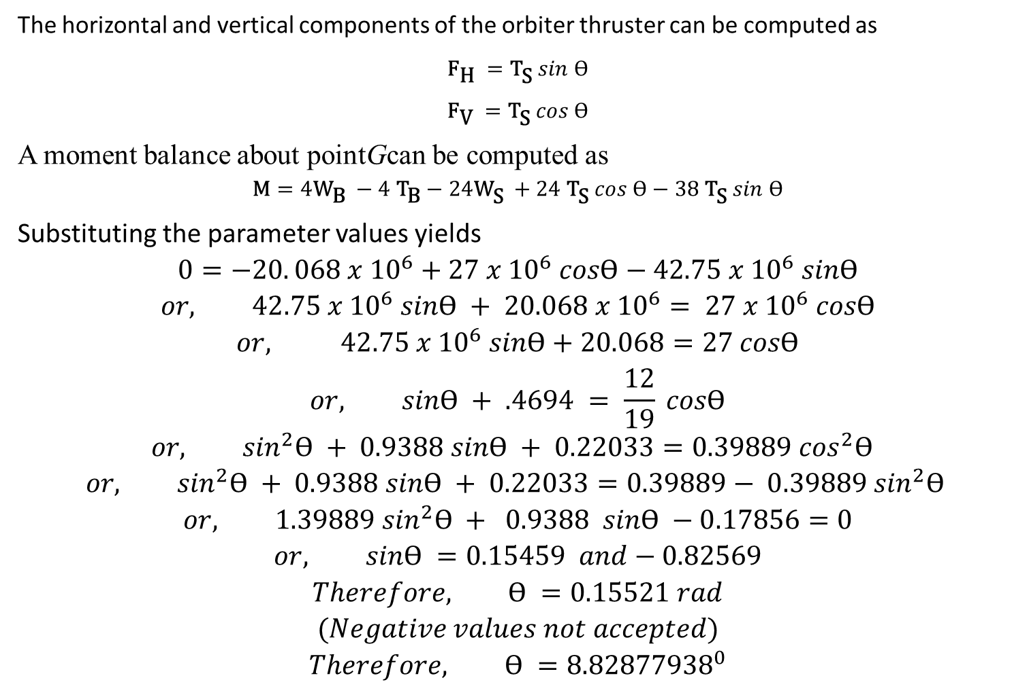
The horizontal and vertical components of the orbiter thruster can be computed as
$${\text{F}}_{\text{H} }={\text{T}}_{\text{S}} sin Ө$$
$${\text{F}}_{\text{V} }={\text{T}}_{\text{S}} cos Ө$$
A moment balance about pointGcan be computed as
$$\text{M}=4{\text{W}}_{\text{B} }−4{ \text{T}}_{\text{B}}−24{\text{W}}_{\text{S} }+24 {\text{T}}_{\text{S}} cos Ө−38 {\text{T}}_{\text{S}} sin Ө$$
Substituting the parameter values yields
$$0=−20. 068 x {10}^{6}+27 x {10}^{6} cosӨ−42.75 x {10}^{6} sinӨ$$
$$or, 42.75 x {10}^{6} sinӨ + 20.068 x {10}^{6}= 27 x {10}^{6} cosӨ$$
$$or, 42.75 x {10}^{6} sinӨ+20.068=27 cosӨ$$
$$or, sinӨ + .4694 = \frac{12}{19} cosӨ$$
$$or, \sin^{2}Ө + 0.9388 sinӨ + 0.22033=0.39889 \cos^{2}Ө$$
$$or, \sin^{2}Ө + 0.9388 sinӨ + 0.22033=0.39889− 0.39889 \sin^{2}Ө$$
$$or, 1.39889 \sin^{2}Ө + 0.9388 sinӨ −0.17856=0$$
$$or, sinӨ =0.15459 and−0.82569$$
$$Therefore, Ө =0.15521 rad$$
$$(Negative values not accepted)$$
$$Therefore, Ө ={8.82877938}^{0}$$

Slide 6
Finding the value of angle when lift off
A moment balance about point G can be computed as,
M=4W_{B}-4W_{s}+24W_{s}+24T_{s}cos𝜃-38T_{s}sinθ
After taking moment equation is equal to 0
We get,
0=4W_{B}-4W_{s}+24W_{s}+24T_{s}cos𝜃-38T_{s}sinθ
Then, from equation the value of angle we got, θ=8.8930ᴼ

Slide 7
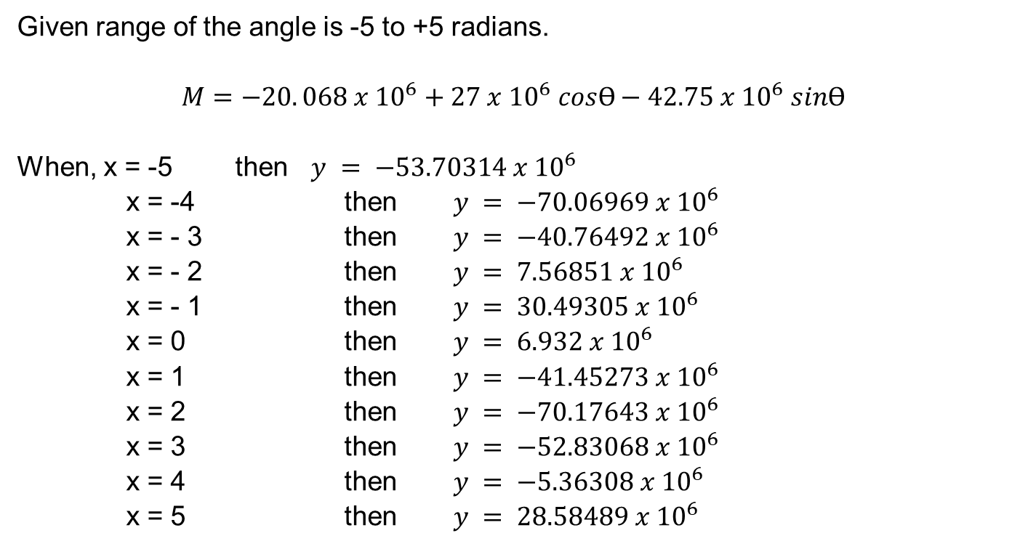
Given range of the angle is -5 to +5 radians.
$$M=−20. 068 x {10}^{6}+27 x {10}^{6} cosӨ−42.75 x {10}^{6} sinӨ$$
When, x = -5 then $y = −53.70314 x {10}^{6}$
x = -4 then $y = −70.06969 x {10}^{6}$
x = - 3 then $y = −40.76492 x {10}^{6}$
x = - 2 then $y = 7.56851 x {10}^{6}$
x = - 1 then $y = 30.49305 x {10}^{6}$
x = 0 then $y = 6.932 x {10}^{6}$
x = 1 then $y = −41.45273 x {10}^{6}$
x = 2 then $y = −70.17643 x {10}^{6}$
x = 3 then $y = −52.83068 x {10}^{6}$
x = 4 then $y = −5.36308 x {10}^{6}$
x = 5 then $y = 28.58489 x {10}^{6}$

Slide 8
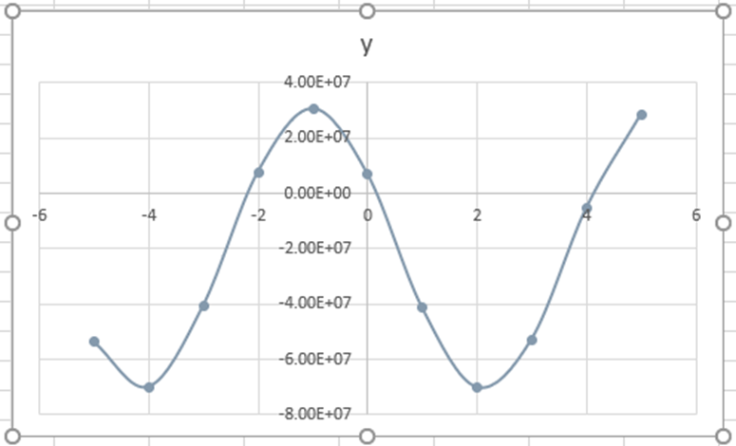
Graph
y= -20.068*10⁶ + 27*10⁶ cos(θ) – 42.75*10⁶ sin(θ)

Slide 9
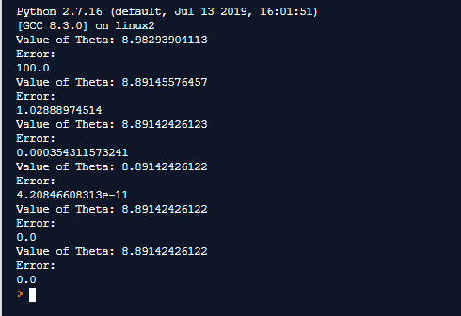
Using of Newton Raphson Method
We get the angle θ after performing iteration 6

Slide 10
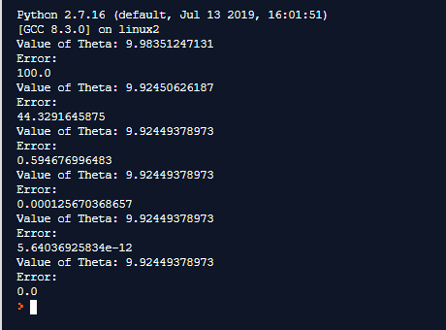
When W_{S}= 195000lb

Slide 11
Thank You

